Slide 1
Medical Appointment No Shows
Why do 30% of patients miss their scheduled appointments?

Slide 2
Daten
300’000 Datensätze
15 Variablen
No.show: factor

Slide 3
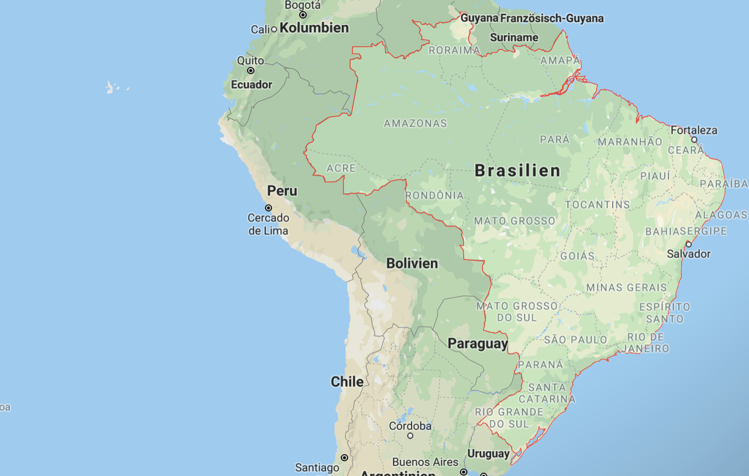
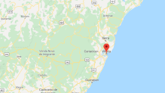
Geografie

Slide 4
